Slide 1
Software Testing and Quality Assurance
Testing in the Software Process

Slide 2
Big Bang Development
Big Bang - wait until all the code has been written and then to test the finished product all at once
It is an attractive option to developers because testing activities do not hold back the progress towards completing the product.

Slide 3
Big Bang Development Drawbacks
However, it is a very risky strategy as the likelihood that the product will work, or even be close to working can be very low,
Also, it is particularly dependent on program complexity and program size.
Additionally, if tests do reveal faults in the program, it is much more difficult to identify their source. It is then necessary to search through the complete program to locate them.

Slide 4
Testing and Development by Stages
Individual modules, or software features, are tested as they are written.
This process continues as additional software increments are produced until the product is completed.
This may have the effect of slowing down the arrival of the final product
However, it should produce one that has fewer errors and that the development team will have much more confidence in.

Slide 5
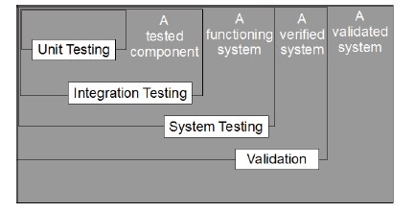
Timeline of developing and testing by stages

Slide 6
A Test Plan
A typical Test Plan would include such information as:
  Items to be tested
  Tasks to be performed
  Responsibilities
  Schedules
  Required resources

Slide 7
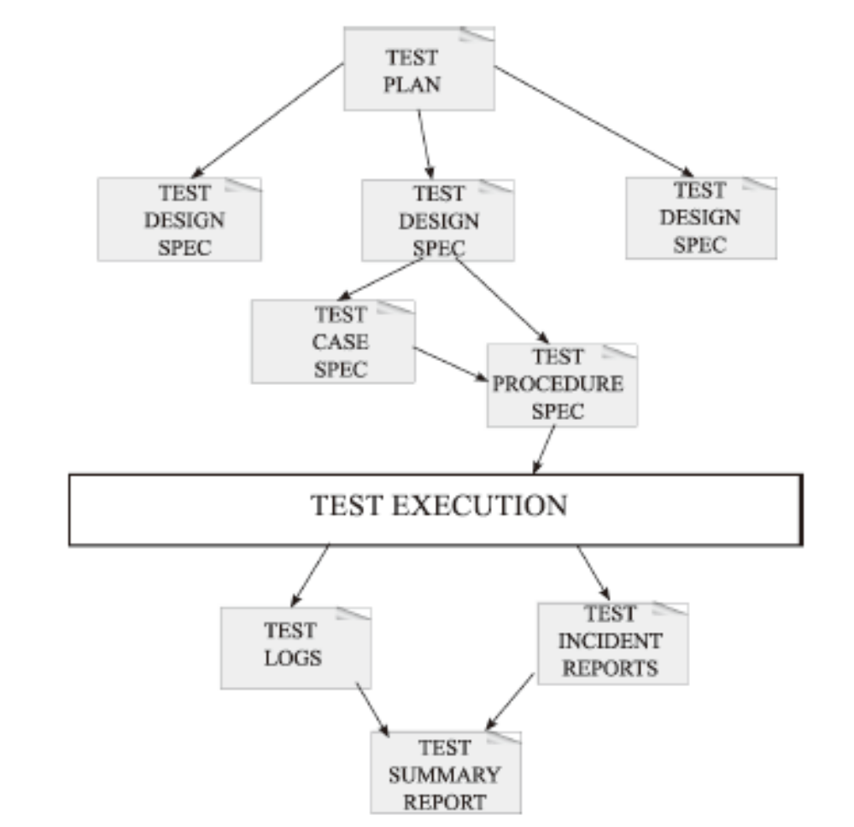
Test Planning – IEEE model
The IEEE standard 892-1998 provides a formal framework within which a plan can be prepared

Slide 8
Software Development Life Cycle
The Software Development Life Cycle is a structured plan for organizing the development of a software product.
The need for such planning arose with the growth in size and complexity of software projects.
By adopting a plan for the development it was intended to create a repeatable and predictable software development process that would automatically improve productivity and quality.

Slide 9
The Waterfall Model
This model visualizes the software development process as a linear sequence of phases
It begins with a requirements analysis, followed by the system design, then coding, testing, and ending with system maintenance after the software has been deployed

Slide 10
The Waterfall Model
All the planning is done at the beginning, and once created it is not to be changed.
There is no overlap between any of the subsequent phases.
Often anyone’s first chance to “see” the program is at the very end once the testing is complete.

Slide 11
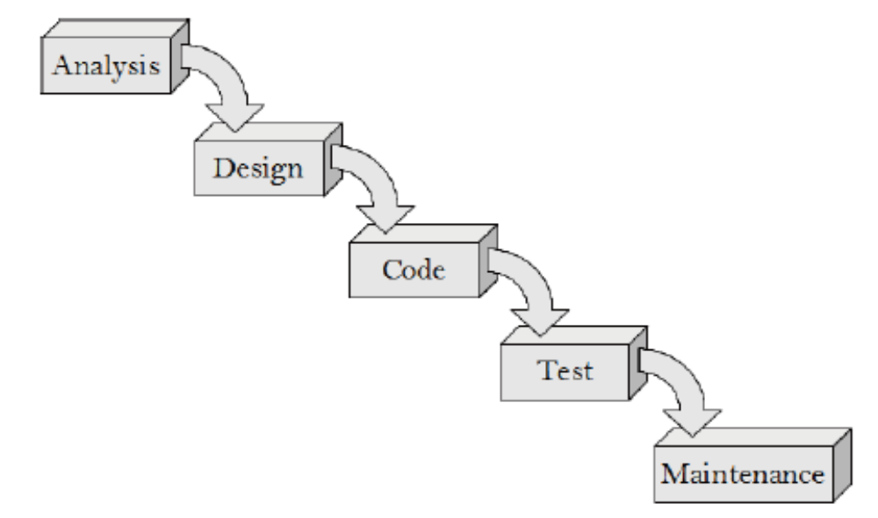
The Waterfall Model

Slide 12
Waterfall Model - Strengths
If time is spent early on making sure that the requirements and design are absolutely correct then this will save much time and effort later.
There is an emphasis on documentation which keeps all knowledge in a central repository and can be referenced easily by new members joining the team.

Slide 13
Waterfall Model - Weaknesses
Few visible signs of progress until the end of the project
It is not flexible to changes
Time-consuming to produce all the documentation
Tests are only carried out at the end – this could mean a compromise if time or budgetary constraints exist

Slide 14
Waterfall Model - Weaknesses
Having to test the program as a whole could result in incomplete testing
If testing does identify a fault that suggests a redesign it may be ignored because of the trouble involved
If the customer is unhappy it may incur a long maintenance phase resolving their issues

Slide 15
The V-model
This is an extension of the Waterfall model but in contrast it emphasizes Verification & Validation by marking the relationships between each phase of the life cycle and testing activities.
Once the code implementation is finished the testing begins.
This starts with unit testing, and moves up one test level at a time until the acceptance testing phase is completed

Slide 16
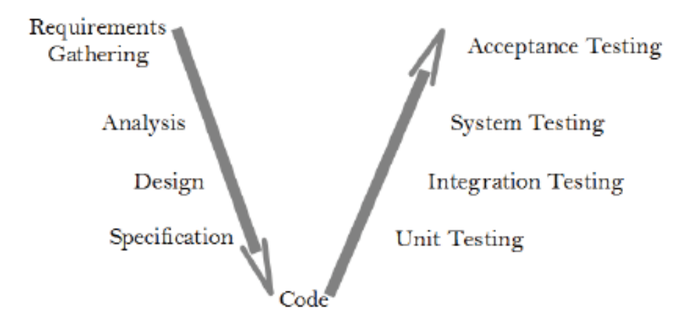
The V-Model

Slide 17
V-Model Documentation
Each document produced is associated with pairs of phases in the model.
These are the
  (a) Detailed Design Specifications,
  (b) the System Design Specifications,
  (c) the System Requirements Specification,
  (d) the User Requirements Specification.

Slide 18
V-Model Documentation
Requirements Gathering produces the User Requirements Specification (URS), which is both the input to Analysis, and the basis for Acceptance Testing.
Analysis produces the System Specification (SS) – also know as the Software Requirements Specification (SRS) – which is both the input for Software Design, and the basis for System Testing.
Design produces the System Design Specification (SDS), which is both the input for the detailed Specification phase, and the basis for Integration Testing.
The Specification activity produces the Detailed Design Specifications (DDS), which are both used to write the code, and also are the basis for Unit Testing.

Slide 19
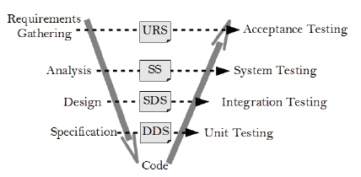
V-Model Documentation

Slide 20
V-model Advantages
It is simple and easy to manage due to the rigidity of the model,
It encourages Verification and Validation at all phases:
Each phase has specific deliverables and a review process.
It gives equal weight to testing alongside development rather than treating it as an afterthought.

Slide 21
V-model Disadvantages
Its disadvantages are that similarly to the Waterfall model there is no working software produced until late during the life cycle
It is unsuitable where the requirements are at a moderate to high risk of changing.
It has been suggested too that it is a poor model for long, complex and object-oriented projects

Slide 22
Agile Development
Agile methods share with other incremental development methods an emphasis on building releasable software in short time periods.
However, Agile development differs from the other development models in that its time periods are measured in weeks rather than months and work is performed in a highly collaborative manner

Slide 23
Agile Development
For effective testing:
  When the developers “negotiate” the requirements for the upcoming iteration with the customers, the testers must be full participants in those conversations.
  The testers immediately translate the requirements that are agreed upon in those conversations into test cases.
  When requirements change, testers are immediately involved because everyone knows that the test cases must be changed accordingly.

Slide 24
Incremental Development
The incremental model begins with a simple implementation of a part of the software system. With each increment the product evolves with enhancements being added every time until the final version is reached.
Testing is an important part of the incremental model and is carried out at the end of each iteration. This means that testing begins earlier in the development process and that there is more of it overall.
Much of the testing is of the form of regression testing, and much re-use can be made of test cases and test data from earlier increments.

Slide 25
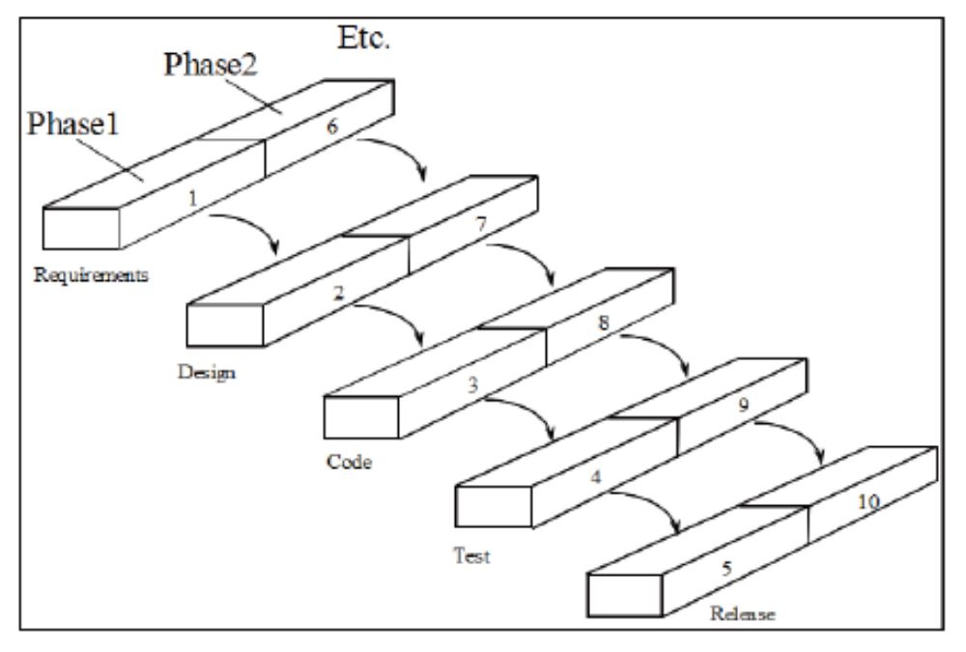
Incremental Development

Slide 26
Incremental Development - Advantages
A major advantage of the incremental model is that the product is written and tested in smaller pieces, reducing risk and allowing for change to be included easily
The customer or users is involved from the beginning which means the system is more likely to meet their requirements and they themselves are more committed to the system

Slide 27
Incremental Development - Disadvantages
It can be difficult to manage because of the lack of documentation in comparison to other models
The continual change to the software can make it difficult to maintain as it grows in size.

Slide 28
Extreme Programming
Extreme Programming (XP) is a subset of the philosophy of Agile software development.
It emphasizes code reviews, continuous integration and automated testing, and very short iterations.
It favours ongoing design refinement (or refactoring ), in place of a large initial design phase, keeping the current implementation as simple as possible.
It favours real-time communication, preferably face-to-face, over writing documents, and working software is seen as the primary measure of progress.

Slide 29
Extreme Programming
The methodology also emphasizes team work. Managers, customers, and developers are all part of a team dedicated to delivering quality software.
Programmers are responsible for testing their own work; testers are focused on helping the customer select and write functional tests, and on running these tests regularly

Slide 30
Extreme Programming - Values
Communication: XP programmers communicate with their customers and fellow programmers
Simplicity: they keep their design simple and clean
Feedback: they get feedback by software testing from the start
Courage: they deliver the system to customers as early as possible and implement changes as suggested, responding with courage to changing requirements

Slide 31
Extreme Programming
A project begins by identifying a metaphor that describes the system. The metaphor acts as a conceptual framework, identifying key objects and providing insight into their interfaces.
The first iteration sets the initial skeleton of the project.
User Stories, in the format of about three sentences of text, are written by the customers. These are the features of the application that the system needs to have and are used to drive the creation of the acceptance tests later on.

Slide 32
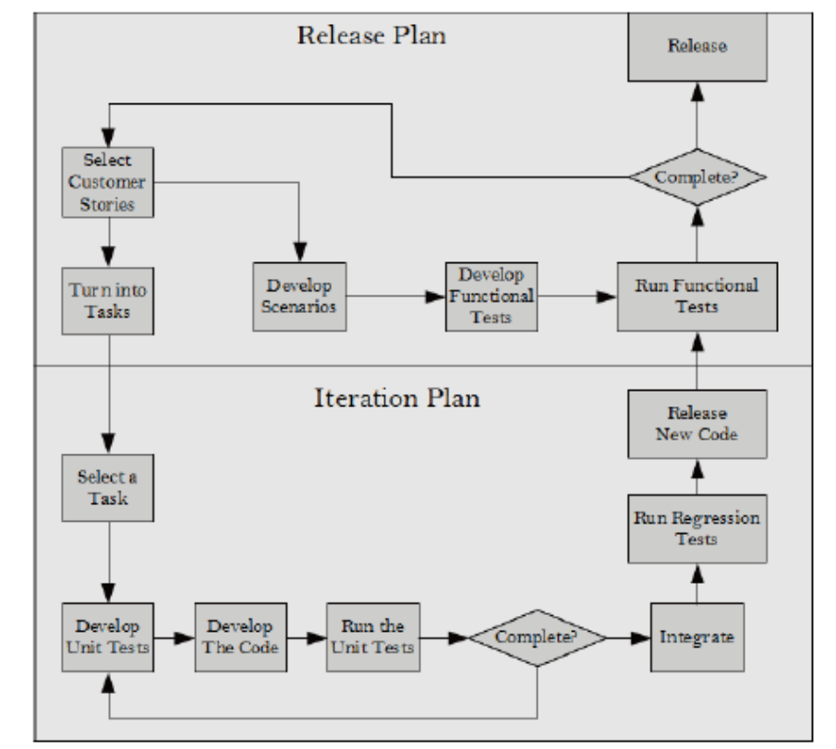
Extreme Programmming

Slide 33
Extreme Programming
A Release Plan is created from the User Stories. This plan sets out the overall project.
Iteration plans are then created for each individual iteration, using development time estimates for each user story.
The customer specifies scenarios to show that a user story has been correctly implemented. A set of functional (or acceptance) tests is developed based on these.
The customers are responsible for verifying the correctness of the acceptance tests, and reviewing test scores to decide which failed tests are of highest priority.
Acceptance tests are also used as regression tests prior to the release of a new version of the software.

Slide 34
Extreme Programming
Each Iteration Plan is developed in detail just before the iteration begins and not in advance. Iterations are between 1 and 3 weeks in duration.
User Stories are converted into implementation tasks, recorded on task cards. A programmer takes a task card, writes the unit test cases for the task, implements the code, and tests it.
When the tests pass, the programmer then integrates the new code, runs regression tests, and releases the code for full functional testing.
After this, there is a tested, working, software feature ready to demonstrate to the customer.
Eventually, after all the iterations have been completed the product will be finished.

Slide 35
SCRUM – Difference with XP
Scrum teams work in iterations that are called sprints. These can last a little longer than XP iterations.
Scrum teams do not allow changes to be introduced during the sprints. XP teams are more flexible with changes within an iteration as long as work has not started on that particular feature already.
XP implements features in a priority order decided essentially by the customer, while in SCRUM there is more flexibility for additional stakeholders to influence the ordering.
In XP unit testing and simple design practices are built in, while in SCRUM it is up to the team to organize themselves.

Slide 36
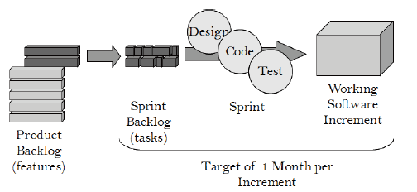
Scrum

Slide 37
Scrum
SCRUM starts with the Product Backlog which is a prioritized list of all product requirements.
The backlog items come from: Users, customers, sales, marketing, customer service, engineering, and anyone else that has an interest in the outcome of the project. The Product Backlog is never finalized, it emerges and evolves with the product.
SCRUM teams take on as much of the product backlog as they think they can turn into an increment of product functionality within a 30-day iteration. This is called a Sprint.
The team maintains a list of tasks to perform during each Sprint that is called the Sprint Backlog.
Multiple teams can take on product increments in parallel, all working from the same Product Backlog. A project will have multiple sprints.

Slide 38
Scrum
Before a sprint starts a meeting is conducted to decide what is going to be developed and delivered in that particular sprint.
After the completion of the sprint, a meeting is held to collect feedback from the team. This feedback helps in planning and working on the next sprint.
As the development team starts to work on the next sprint, the testing team carries out functional testing of the features developed in the last sprint.
This approach gives good results as the testing team works with the developers from the start of the project.

Slide 39
Organizing the stories – A user story map
This is related to the product backlog in SCRUM
The map outlines the big picture
The product backlog approach usually arranges the stories in a build order from the highest value to lowest value – this suits project managers!
However, it is better to arrange a user story map so that it is clear what the system does.

Slide 40
User Story Map
On top are the big stories/activities. These are the essentials of the software.
Each big story will break down into smaller stories/tasks such as “send message” and “” receive message”.
The smaller tasks are prioritized from absolutely necessary to being a nice extra feature.

Slide 41
Devops
DevOps – a combination of Development & Operations – is a software development methodology which looks to integrate all the software development functions from development to operations within the same cycle.
This calls for higher level of coordination within the various stakeholders in the software development process (namely Development, QA & Operations)

Slide 42
Devops
Requires Continuous Integration combined with Continuous Delivery
This approach places great emphasis on automation of build, deployment and testing.

Slide 43
Devops
Build tools help to achieve fast iteration,
Continuous-Integration (CI) tools to merge code from multiple developers and check for faults.
Additionally, when the software is in operation, Logging provides traces for identifying and tracking application faults

Slide 44
DevOps and Project Managers
Complex software architectures and features must be decomposed into small chunks that can be produced and deployed independently.
ˆVisibility of the configuration and build must be ensured so that everyone is aware of what is deployed, with which versions and dependencies.
The shift must be made from legacy practices to those that facilitate the integration of development and operations.

Slide 45
DevOps and Testing
Developers assume responsibility for both the testing and release environment.
The development team performs test-driven development and CI.
The use of CI means that the system is constantly being tested

Slide 46
DevOps and Testing
To accelerate this activity, those responsible for quality assurance must ensure automation of all test cases and full code coverage.

Slide 47
Benefits of Devops
Faster Time to market – reduced cycle times and higher deployment rates
Increased Quality – better availability of the product as it is being created, increased change success rate and fewer failures
Increased organizational effectiveness – more time spent on value adding activities and greater value being delivered to the customer

Slide 48
Difficulties
DevOps requires high level of coordination between various functions of the deliverable chain.
A need to master the various automation and continuous integration tools

Slide 49
InternationalComparisons
2003 IEEE Software
Survey: Completed in 2002-2003
Objective: Determine usage of iterative versus Waterfall-ish techniques, with performance comparisons
  118 projects plus 30 from HP-Agilent for pilot survey
Participants
  India: Motorola MEI, Infosys, Tata, Patni
  Japan: Hitachi, NEC, IBM Japan, NTT Data, SRA, Matsushita, Omron, Fuji Xerox, Olympus
  US: IBM, HP, Agilent, Microsoft, Siebel, AT&T, Fidelity, Merrill Lynch, Lockheed Martin, TRW, Micron Tech
  Europe: Siemens, Nokia, Business Objects

Slide 50
Observations
Most projects (64%) are not pure waterfall; 36% were
Mix of “conventional” and “iterative” common
Best “nominal” quality from traditional “waterfall” (fewer cycles & late changes implies less bugs)
Best balance of quality, flexibility, cost, & speed from combining conventional & iterative practices
However, differences in quality between waterfall & iterative disappear if a bundle of techniques of used:
  Early prototypes (get customer feedback early)
  Design reviews (continuously check quality of design)
  Regression tests on each build (continuously check quality of code and functional status)

Slide 51
Process related quality and standards models - CMM
The Capability Maturity Model was developed initially by the Software Engineering Institute at Carnegie Mellon University in 1991 as a model based on best practices for software development.
The CMM ranks software development organizations in a hierarchy of five levels, each with a progressively greater capability of producing quality software

Slide 52
CMM Levels
Level 1 – Initial (also referred to as Chaotic or Ad Hoc). Processes are typically undocumented and dynamic. They are driven in an uncontrolled, reactive manner by users or events.
Level 2 – Repeatable. Processes are repeatable, possibly with consistent results. Process discipline is unlikely to be rigorous, but where it exists it may help to ensure that existing processes are maintained during times of stress.
Level 3 – Defined. Defined and documented standard processes are established and subject to some degree of improvement over time. These processes are used to establish consistency of process performance across the organization.

Slide 53
CMM Levels
Level 4 – Managed. Using process metrics, management effectively controls the process. This includes identifying ways to adjust and adapt the process to particular projects without measurable losses of quality or deviations from specifications.
Level 5 – Optimizing. The focus is on continually improving process performance through both incremental and innovative technological changes/improvements.

Slide 54
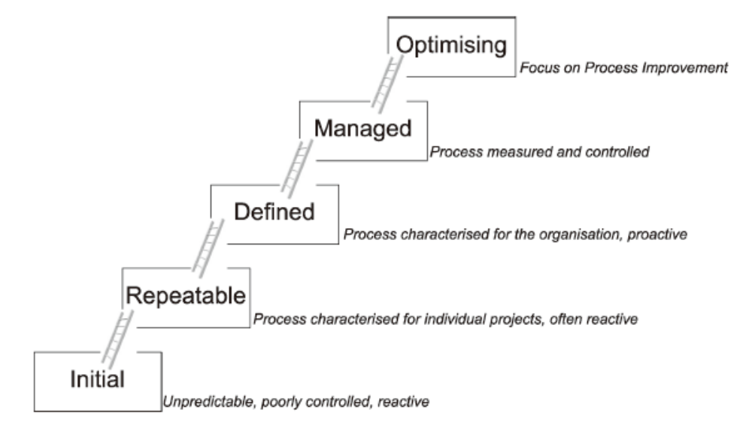
CMM Levels

Slide 55
CMMI
CMMI defines a number of roles and Software Engineering process areas.
Testing is mainly associated with the Software Quality Assurance (SQA) and Software Quality Control (SQC) roles in the CMMI model. The main test activities are in the following Software Engineering process areas:
  CMMI Technical Solution – Unit Testing
  CMMI Product Integration – Integration Testing
  CMMI Verification – System Testing
The test results provide a measure of the process quality, used as a significant input to the Process Assessment and Improvement activity.

